Slide 1
CharArrayReader
CharArrayReader uses a character array as the source.
The Java CharArrayReader class (java.io.CharArrayReader) enables you to read the contents of a chararray as a character stream.
The Java CharArrayReader is handy when you have data in a char array, but need to pass that data to some component which can only read from a Reader (or a Reader subclass). Simply wrap the char array in a CharArrayReader and pass it to that component.
CharArrayReader
Java Application
Read
Read
Char Array

Slide 2
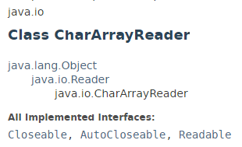
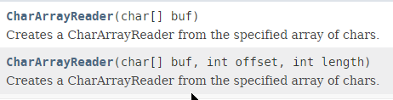
CharArrayReader

Slide 3
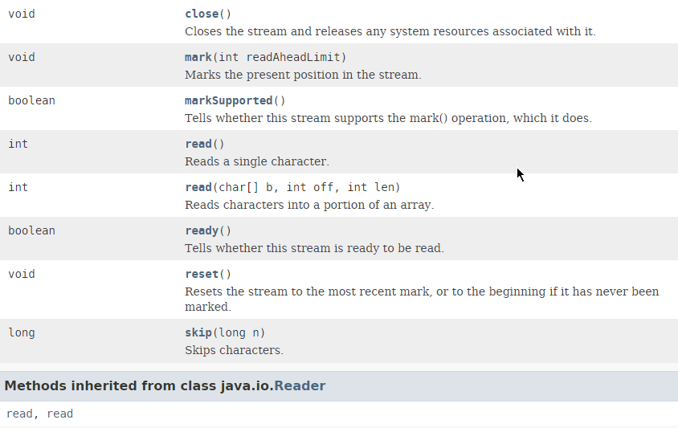
CharArrayReader

Slide 4
CharArrayReader
https://docs.oracle.com/javase/8/docs/api/index.html?java/io/CharArrayReader.html

